Slide 1
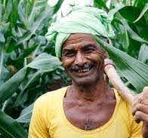
PUTTING FARMERS FIRST
Government of India

Slide 2
Need for Reform
Disparity between Agriculture & other sectors despite economic liberalisation
Fragmented and insufficient markets with high market fees & charges
Inadequate infrastructure and credit facilities
Information asymmetry
Restriction in licensing

Slide 3
Farmer's Produce Trade and Commerce (Promotion and facilitation) Act, 2020
Freedom of Choice of sale & purchase of farmers’ produce at remunerative prices
Efficient transparent and barrier free inter and intra-state trade and commerce outside physical premises of APMCs
APMCs will continue to function: Act provides farmers with additional marketing channels
No bearing on MSP
Payment has to be made to farmers on the same day or within 3 working days where procedure so requires
Permits online trading

Slide 4
Farmers (Empowerment and Protection) Agreement on Price Assurance and Farm Services Act, 2020
Legal framework for agreements between farmers and sponsors for purchase of farming produce and provision of farm services entered into before harvest
Guidelines for model farming agreements by Central Government
Price of the produce will be clearly mentioned in the contract
Clearly specified dispute resolution mechanism: Protecting rights of both farmers and buyers

Slide 5
Essential Commodities (Amendment) Act, 2020
Act invoke only in an extraordinary situation:
War
Famine
Extraordinary price rises
Natural calamities
Imposition of stock limits only be based on price rise and can only be imposed if there is 100% increase in retail price of horticultural produce and a 50% increase in the retail price of non-perishable produce

Slide 6
Benefits of Farm Reforms
Single unified market
Freedom for farmers to sell their produce to whom they want and where they want
End of APMC cartel monopoly
MSP continues to act as safety net for farmers
Legal framework protecting farmer rights
Reduction in market fees, taxes etc. and better price discovery
Development of infrastructure close to farm gate
Contract farming: Form of price assurance and boost linkages with food processing sector
Farming can become profitable even for small & marginal farmers

Slide 7
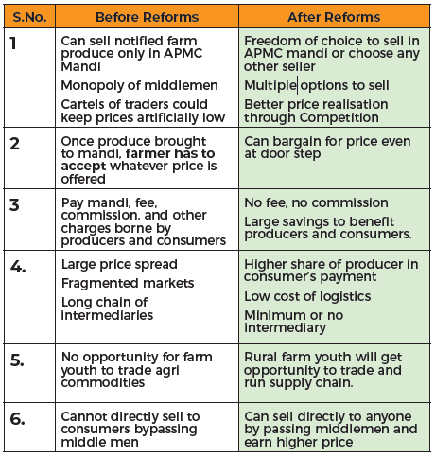
Benefits of Farm Reforms

Slide 8
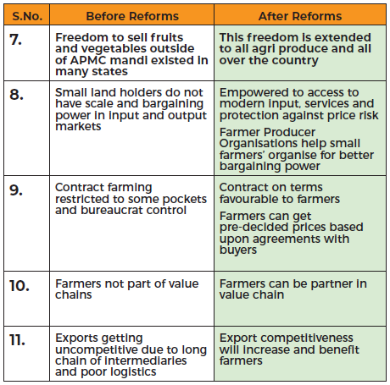
Benefits of Farm Reforms

Slide 9
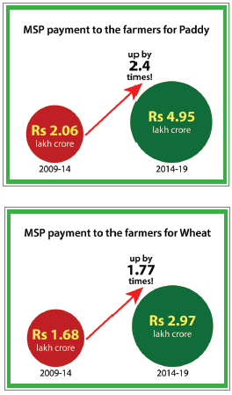
Increase in Procurement from Farmers
Compared with 2009-10 to 2013-14, MSP payment increased during last 5 years by
2.4 times for paddy (Rs. 4.95 lakh crores)
75 times for pulses (Rs. 49,000 crores)
10 times for oilseeds and copra ( Rs. 25,000 crores)
1.77 times for wheat (Rs. 2.97 lakh crores)

Slide 10
Myth vs Reality
Myth | Reality
Farmers will not benefit from Farm Laws | Farmers can choose their buyers and decide their price
No scope for dispute resolution for farmers | Act promotes dispute resolution in a time bound manner with minimum cost at the level of local SDM’s
Farmers won’t get timely payment | Buyers to pay farmers on the same day or within 3 days on agreement
Farmer organisations will not benefit | All Farmer Organisations will be treated as “Farmers” and they will get the same benefits
MSP will not continue | MSP will continue as before
FCI will stop procurement from farmers | FCI and other Government agencies will continue procurement from farmers as before

Slide 11
Myth vs Reality
Myth | Reality
Farmers need license to sell outside APMC mandis | Farmers can sell produce outside mandis to buyer who gives best price; without registration/ transaction fee
APMC mandis will close down in future | Mandi system will continue as before
Act invades rights of State APMCs | Act does not dilute APMC Act. It allows for additional trade outside mandis
Act doesn’t safeguard farmer payments | Act provides sufficient guidelines to safeguard farmers interests
Act will lead to agriculture land acquisition by corporates | Act bars transfer of farmer land/ permanent structure.

Slide 12
Consultation Process
Stakeholder consultations on agriculture issues have continued for past two decades by various Governments
Expert Committee (2000) under Shri Shankarlal Guru suggested inter-alia repeal of Essential Commodities Act, 1955, promotion of direct marketing and involvement of private sector in marketing extension services
Inter-Ministerial Task Force (2002) recommendations include revitalisation of marketing system, reforms in APMC Act and encouraging contract farming
Model APMC Act, 2003 on agriculture marketing formulated in consultation with State Governments: Model APMC Rules formulated in 2007
Model APMC Act, 2003 adopted by 18 States

Slide 13
Consultation Process
National Commission on agriculture under Shri M.S. Swaminathan (2006) recommended promotion of Unified National Market
Committee of State Ministers in charge of agricultural marketing constituted for extensive consultations (2010)
Formulation of Model APLM Act, 2017 to remove fragmentation of market and promotion of National Market for Agriculture Produce
Adopted by 5 States
Regular engagement with States has continued before promulgation of the Farm Ordinances (June 2020)
Extensive steps taken to sensitise farming communities, FPOs and cooperatives for awareness of One Nation, One Market

Slide 14
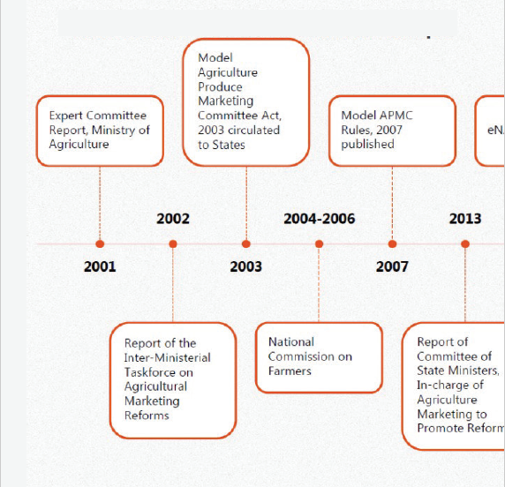
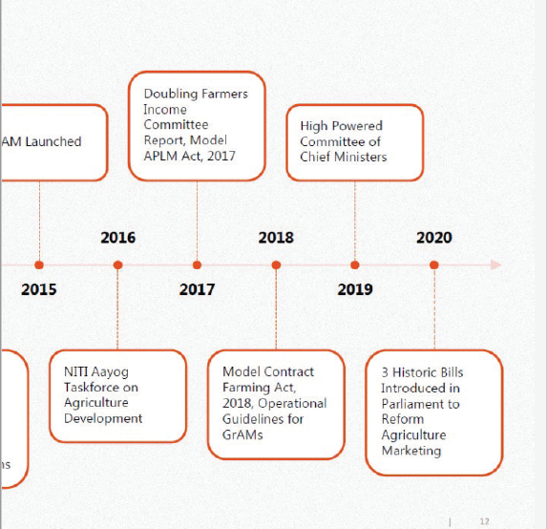
Consultation Process: Timeline

Slide 15
THANK YOU

